Slide 1
Introduction to CSS 3
Bhawna Gunwani
Corporate Trainer and Consultant

Slide 2
Introduction to CSS 3

Slide 3
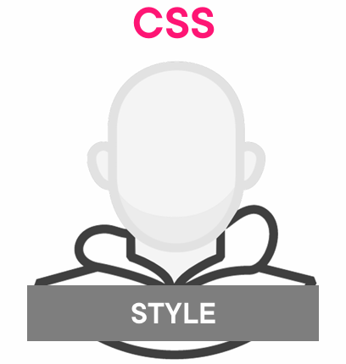
Introduction to CSS 3
CSS3 is the latest version of Cascading Style Sheets, used for styling web pages.
Split into smaller modules for easier updates.
Supports transitions and keyframe animations.
Uses media queries for adapting to screen sizes.
Reduces image usage for faster loading.

Slide 4
Including CSS into HTML Document
Inline CSS:
Applied using a <style> attribute
Only affect a single HTML element
Mixes presentation and structure

Slide 5
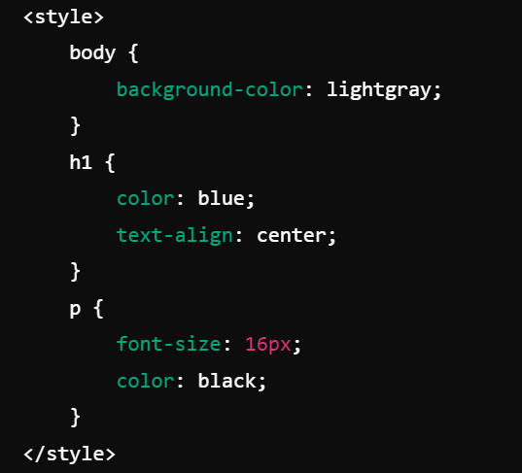
Including CSS into HTML Document
Internal CSS (Embedded CSS):
Styles contained in a <style> element
Specific to a single HTML file.

Slide 6
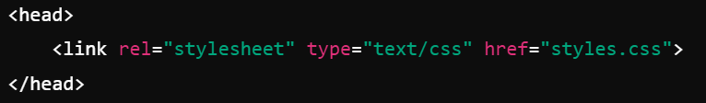
Including CSS into HTML Document
External CSS:
CSS is stored in its own file
Changes can be made in a single location
This is the preferred method for larger websites because it separates content (HTML) from design (CSS) and allows for reusable styles across multiple pages.

Slide 7
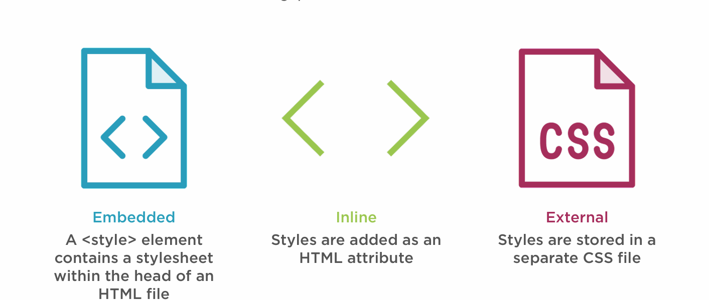

Slide 8
CSS Selectors

Slide 9
CSS Selectors
Universal Selector (*)
Type Selector (Element Selector)
Class Selector (.classname)
ID Selector (#idname)
Attribute Selector
Descendant Selector (element1 element2)

Slide 10
CSS Selectors
Child Selector (element1 > element2)
Adjacent Sibling Selector (element1 + element2)
General Sibling Selector (element1 ~ element2)
Pseudo-Class Selector
Pseudo-Element Selector
Note: Refer to given document for more Information.

Slide 11
CSS Rule Syntax

Slide 12
CSS Rule Syntax
Specifies the HTML element(s) to style.
Contains one or more declarations inside curly braces {}.
Each declaration consists of a property and a value, separated by a colon ‘ : ’ .
The CSS attribute you want to style (e.g., color, font-size).
The setting for the property (e.g., red, 16px).

Slide 13
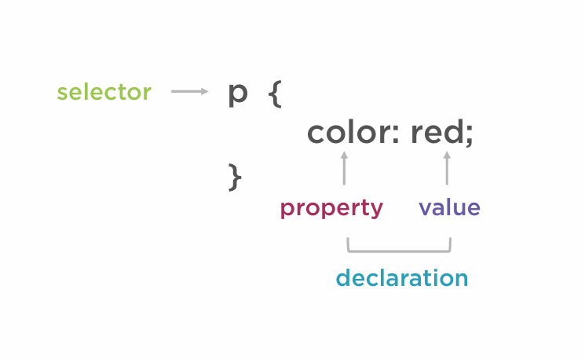

Slide 14
CSS Text Styles

Slide 15
CSS Text Styles
Color: sets the text color.
font-family: specifies the font of the text.
font-size: Defines the size of the text.
font-weight: Controls the boldness of the text.
font-style: Sets the style of the font (normal, italic, or oblique).
text-align: Aligns text horizontally (left, right, center, justify).

Slide 16
CSS Text Styles
text-decoration: Adds decoration like underline, overline, line-through.
letter-spacing: Adjusts the space between characters.
line-height: Sets the space between lines of text.
text-transform: Controls text capitalization (uppercase, lowercase, capitalize).
word-spacing: Adjusts the space between words.
Note: Refer to given document for more Information.

Slide 17
CSS Color

Slide 18
Defining Color Values
Colors in CSS most often specified in the following formats:
Color keyword - like "red", "green", "blue", "transparent", etc.
HEX value - like "#ff0000", "#00ff00", etc.
RGB value - like "rgb(255, 0, 0)"

Slide 19
CSS Background

Slide 20
CSS Background
Used to control the background styling of HTML elements.
Includes colors, images, and positioning for flexibility.
Allows control over size, repeat patterns, and attachment behavior.
Enhances user experience with visually appealing backgrounds.

Slide 21
CSS Background
background-color: Sets the background color of an element.
background-image: Adds an image as the background.
background-position: Positions the background image.
background-repeat: Controls whether the background image repeats.
background-size: Resizes the background image (cover, contain, custom sizes).
background-attachment: Fixes the background relative to the viewport.

Slide 22
CSS Fonts

Slide 23
CSS Fonts
Control the appearance and style of text on a webpage.
Use web-safe fonts or custom fonts (via @font free).
Includes size, weight, style, and variant for flexibility.
Allows embedding of non-standard fonts using @font free.
Enables dynamic text size adjustments for different devices.
Improves readability and visual design with precise text control.

Slide 24
CSS Fonts
font-family: Specifies the font of the text.
font-size: Defines the size of the font.
font-weight: Sets the thickness of the font (normal, bold, etc.).
font-style: Controls the style of the font (normal, italic, oblique).
font-variant: Displays text in small-caps or normal.
font-stretch: Adjusts the width of the font (condensed, expanded).
@font-face: Allows custom fonts to be loaded.
line-height: Sets the height of the line (space between lines of text).

Slide 25
Styling Links with CSS

Slide 26
CSS Links
Links or hyperlinks are an essential part of a website.
It allows visitors to navigate through the site.
Therefore, styling the links properly is an important aspect of building a user-friendly website.

Slide 27
CSS Links
A link has four different states — link, visited, active and hover.
These four states of a link can be styled differently through using the following anchor pseudo-class selectors.
a:link - define styles for normal or unvisited links.
a:visited - define styles for links that the user has already visited.
a:hover - define styles for a link when the user place the mouse pointer.
a:active - define styles for links when they are being clicked.

Slide 28
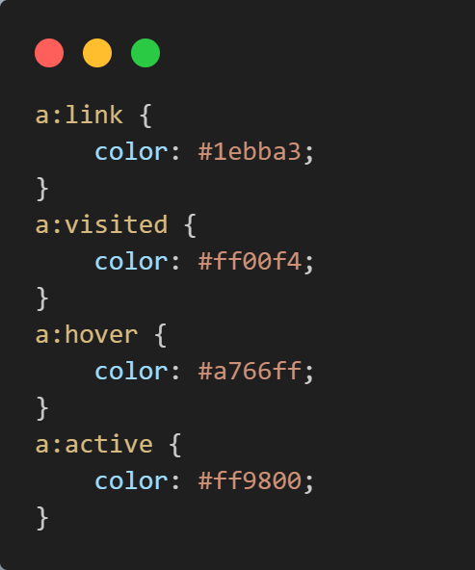
Setting Custom Color of Links

Slide 29
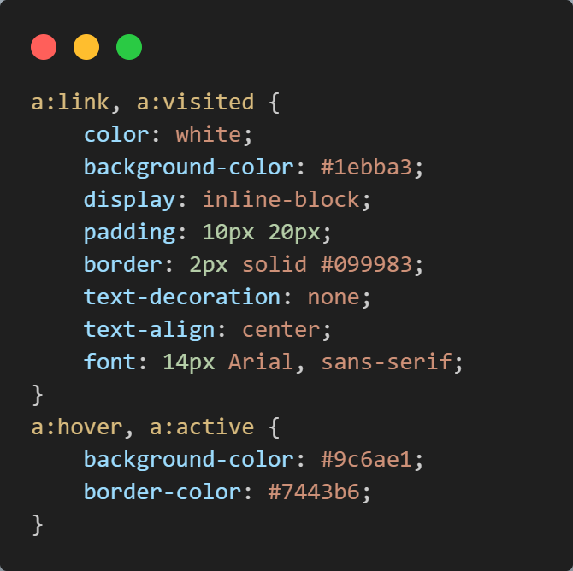
Making Text Links Look Like Buttons

Slide 30
Styling Lists with CSS

Slide 31
CSS Lists
CSS provides the several properties for styling and formatting the most used unordered and ordered lists. These CSS list properties typically allow you to:
Control the shape or appearance of the marker.
Specify an image for the marker rather than a bullet point or number.
Set the distance between a marker and the text in the list.
Specify whether the marker would appear inside or outside of the box containing the list items.

Slide 32
CSS Lists
list-style-type: Defines the bullet or numbering style (e.g., disc, circle, decimal).
list-style-position: Sets the position of the bullet (inside or outside the list item).
list-style-image: Uses a custom image as the list marker.

Slide 33
Styling Tables with CSS

Slide 34
CSS Tables
Tables are typically used to display tabular data, such as financial reports.
CSS provides several properties that allow you to control the layout and presentation of the table elements.

Slide 35
CSS Tables Elements
border-collapse: Controls whether table borders are collapsed or separated.
border-spacing: Sets the space between table cells.
table-layout: Controls the table's layout algorithm (fixed or auto).

Slide 36
CSS Tables Elements
caption-side: Positions the table caption (top or bottom).
text-align: Aligns text within table cells.
vertical-align: Aligns text vertically within table cells.
width: Adjusts the width of table columns or entire table.

Slide 37

It’s a Wrap!

